Slide 1
Google Cloud IoT PLATFORM

Slide 2
Solution overview of prediction of the forest fire detection using IoT core in Google cloud
Business Problem
Solution Approach
Forest fires are danger map at a regional scale is considered at an utmost importance
These fire claim around 1.2 million hectors of forest which was estimated as x million in x years
Predicting forest fires could have larger benefits to the human health and life, economy and the environment.
Can be able to protect/reduce damage to parks in due to human negligence.
Opportunity
Benefits
Forest fires are major environmental issue creating economical and ecological damage while endangering human lives. Fast detection is a key element for controlling such phenomenon
Each year about 60,000-80,000 forest fire occurs destroying between 3-10 million hectares.
Helps in controlling sudden increase in carbon dioxide in atmosphere, reducing greenhouse effect and climate change.
Accurate results and high portability adds to improved customer experience
IoT based device and analytics improves the usability and can be implemented across various areas

Slide 3



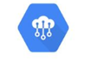





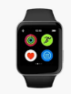
Functional Architecture of IoT Platform in GCP
Integration Layer
Dashboards
Integration ERP
App /Website
Data Pipeline
Google Cloud Layer
Authentication,
Authorization &
Management of devices
Reading and Transforming Streaming telemetry data
from devices
Storing Streaming telemetry data & Historical data
Statistical and
Predictive analysis
of data
Data source Layer
Sensor Devices
Cognisense
Platform
Wearables
Machine learning
(Big query ML,
Cloud Auto ML, etc.)
NLP/Computer Vision
(Vision API, NLP, Translate AI, etc.)
Big Data Solutions
(Data Proc, Data Fusion, etc.)
Key Components of IOT Platform:
Data source layer: Telemetry Data is collected from physical sensors or from cognisense platform and uploading historical data .
Cloud layer: Management of devices, Reading, Storing, and Analyzing data obtained from Data source layer
Presentation layer: Generating insights by using results obtained from Cloud layer.

Slide 4
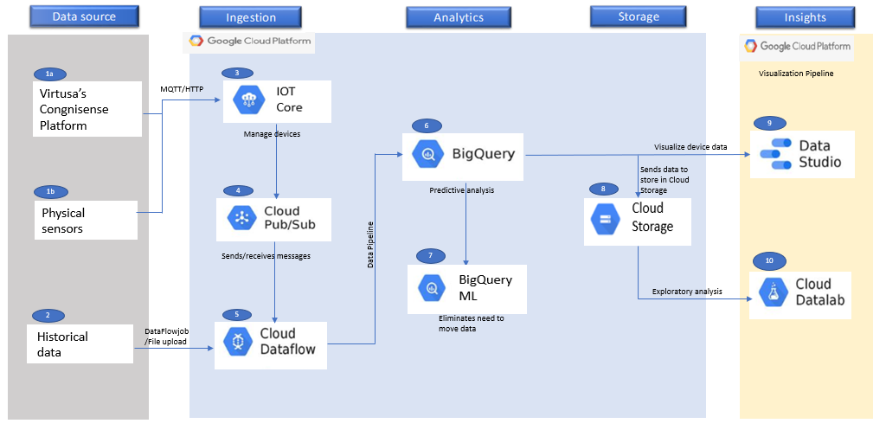
Technical Architecture of IOT Platform in GCP

Slide 5
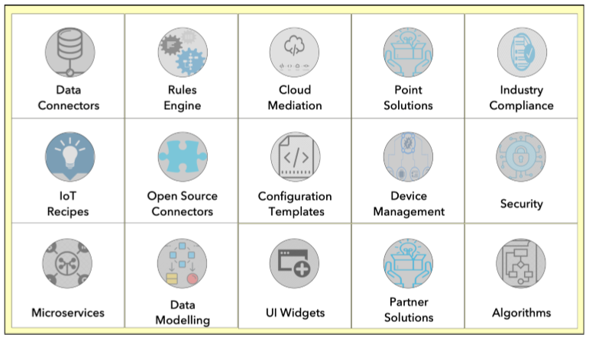
Our CogniSense Platform can adapt to multi-protocol H/W infrastructure and a platform independent cloud application builder with an integrated analytical engine
Cogninse Platform:
Capabilites
Planning and architectural consulting
Transformation planning
Joint KPI planning
Solution Design and development
Partner in demonstrating point of value for outcomes
Solution deployment

